Slide 1
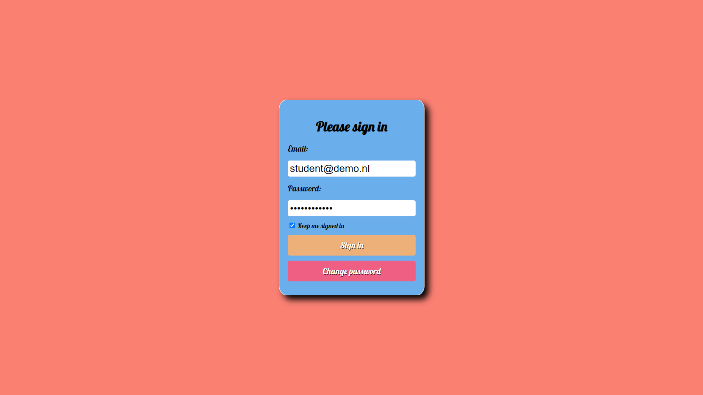

Slide 2
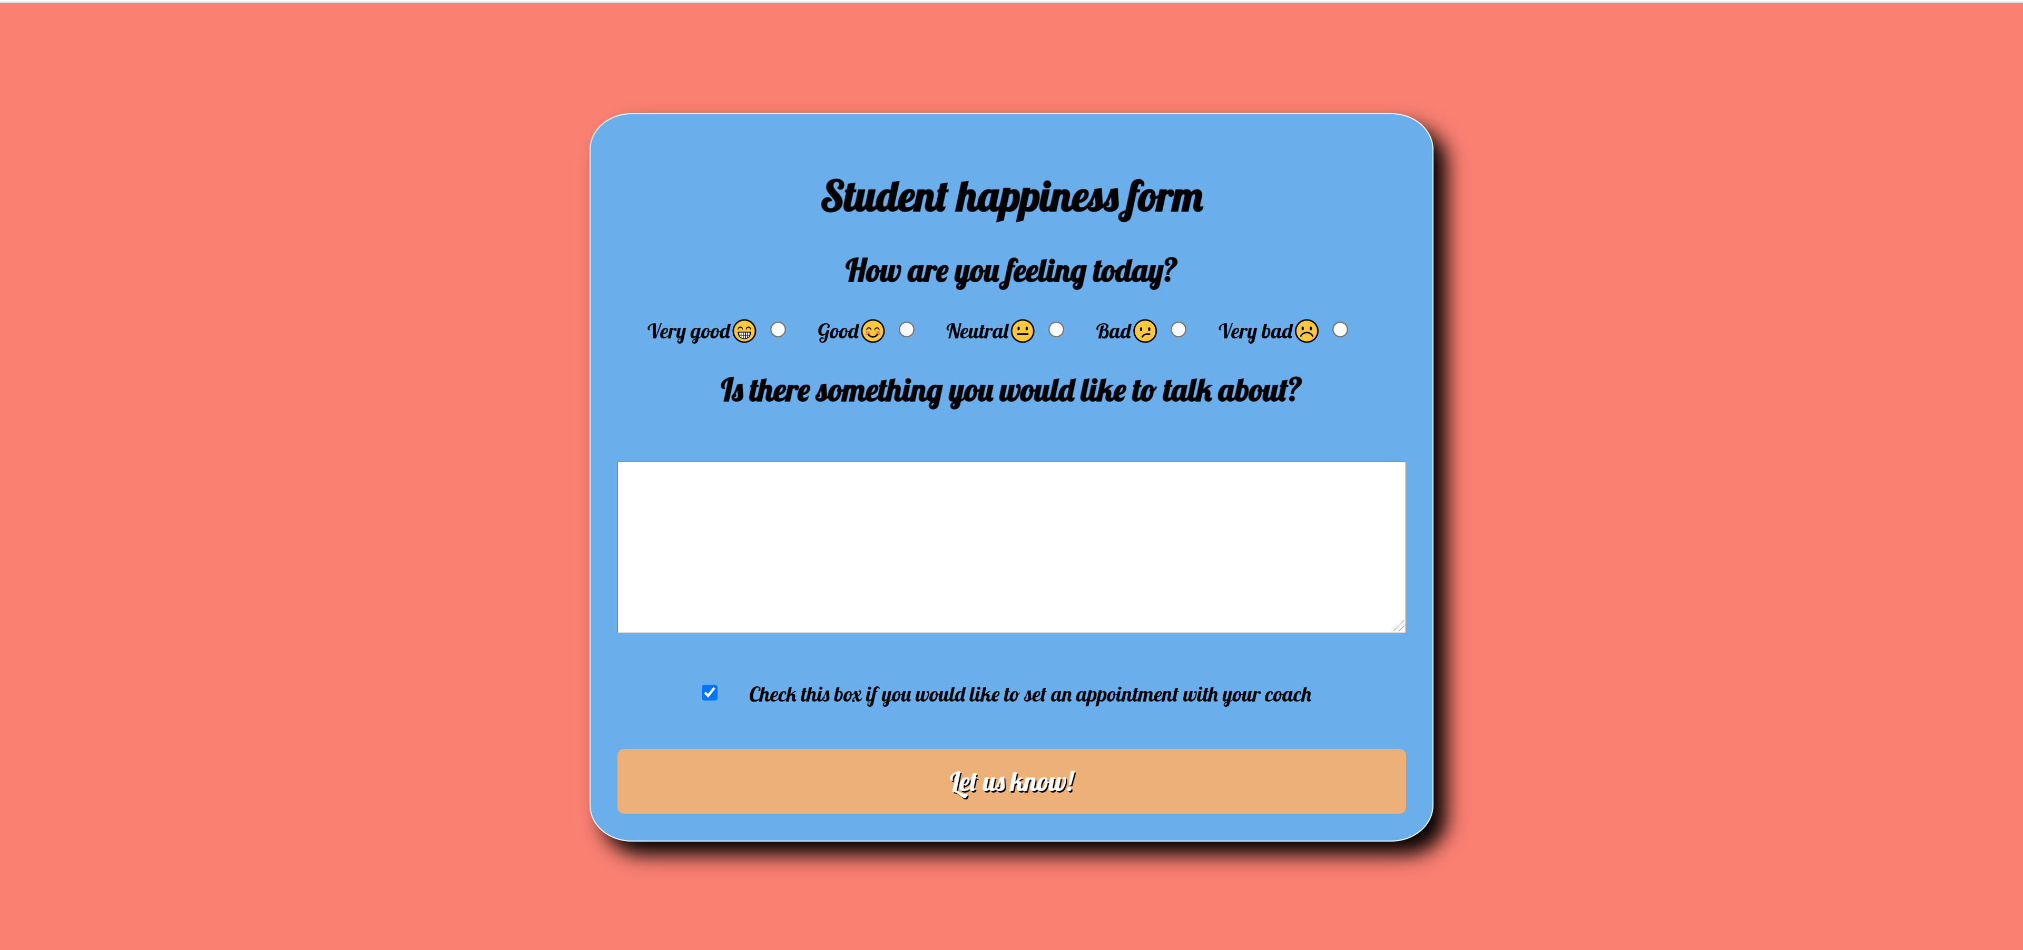

Slide 3
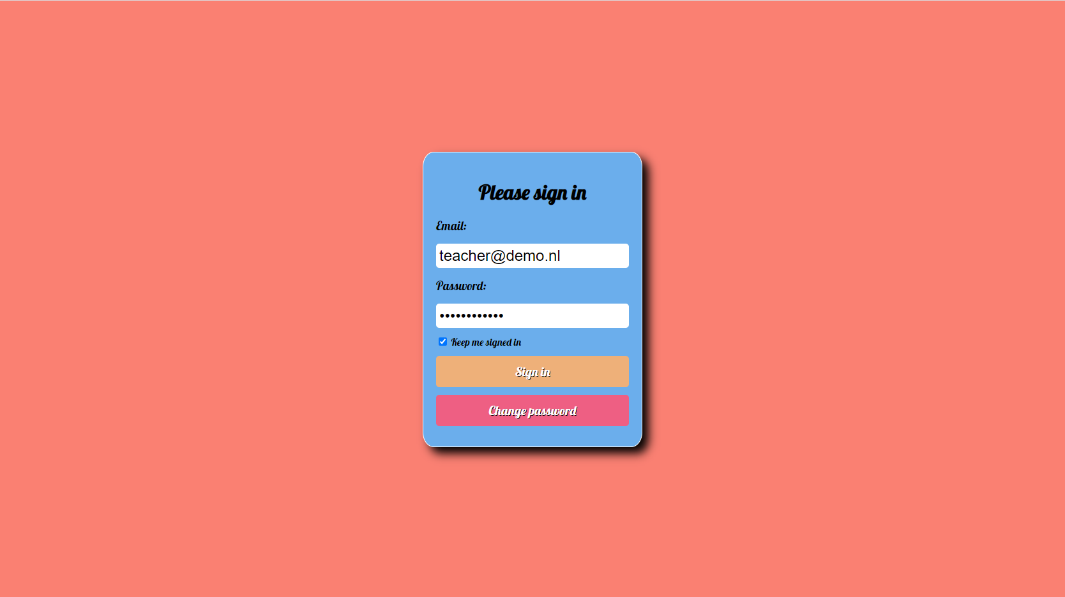

Slide 4
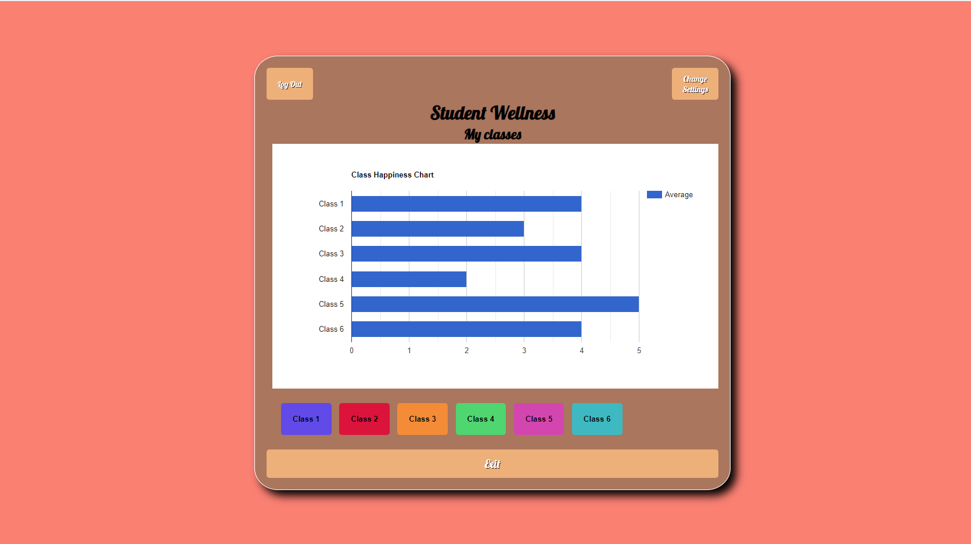

Slide 5
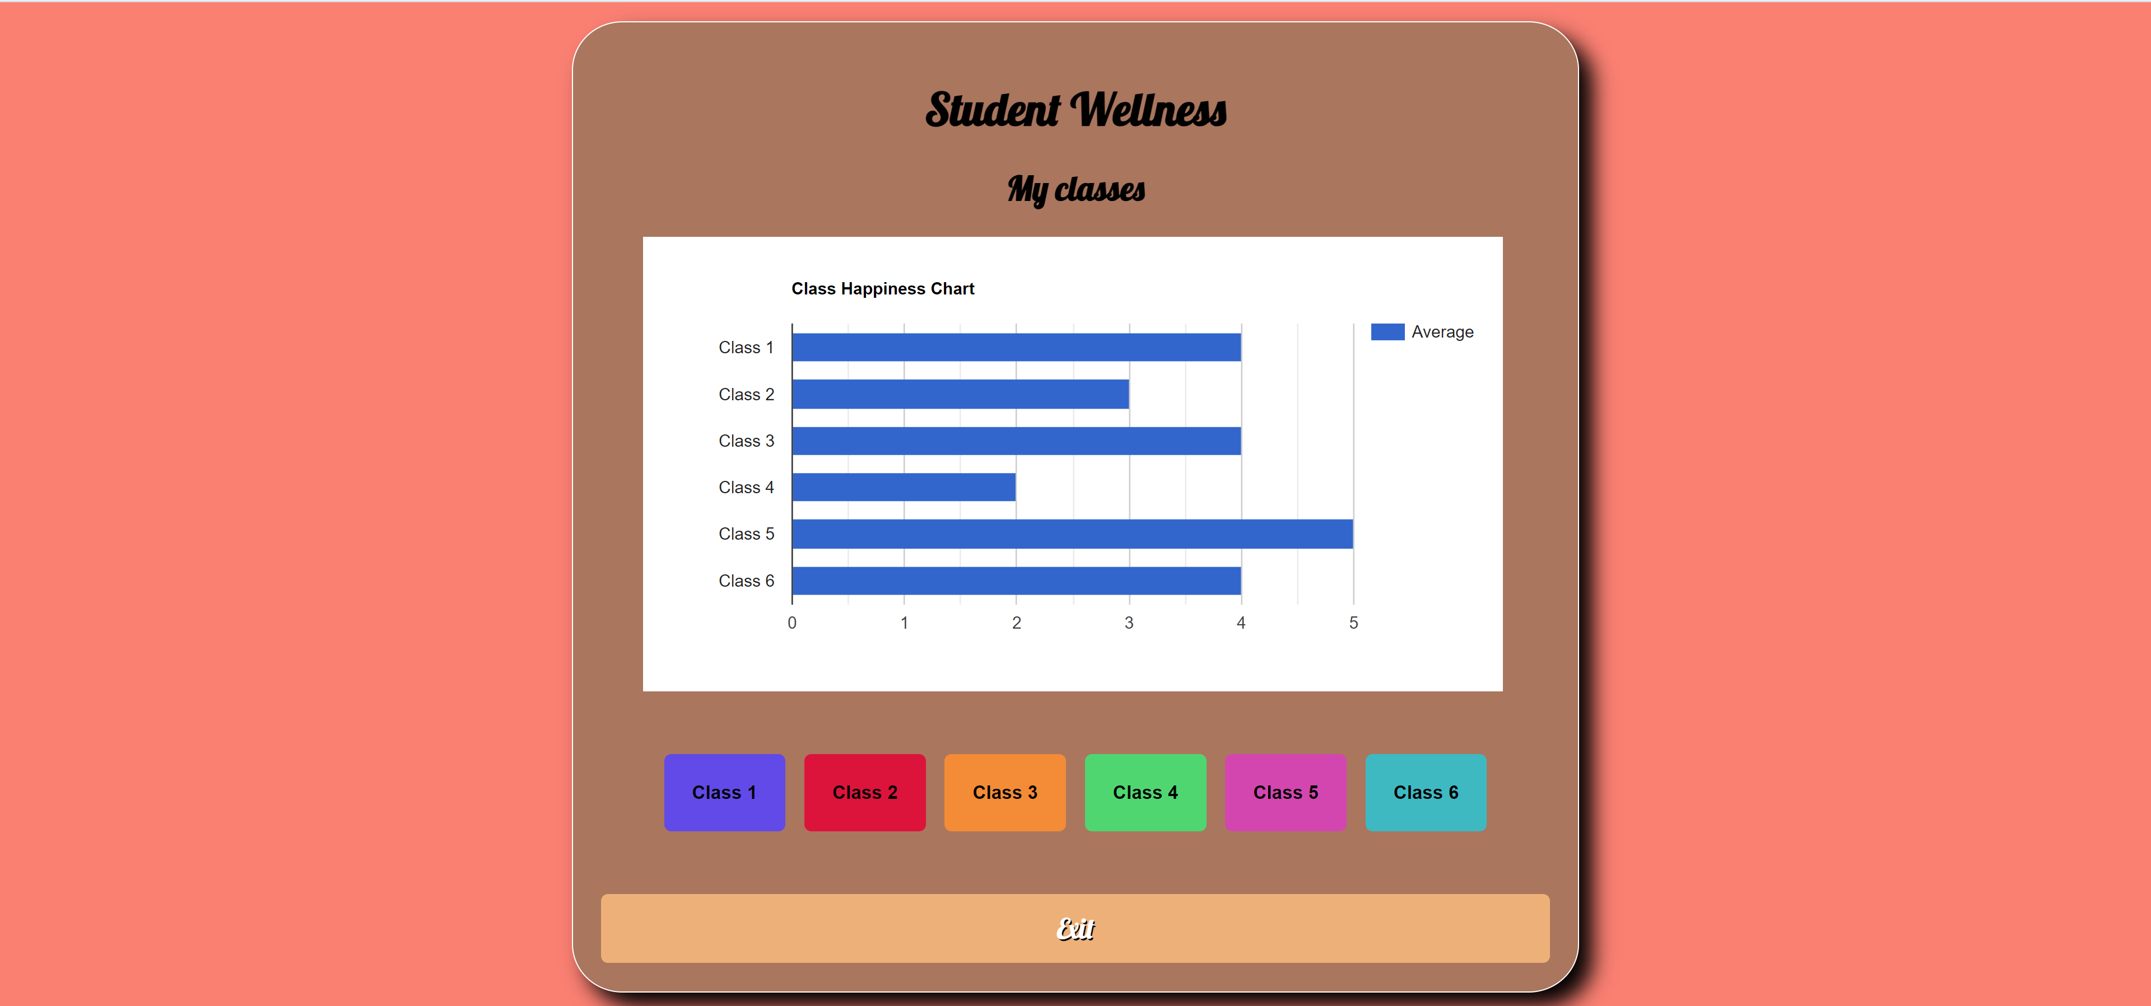
Student ID | Name | Todays score | AVG 7 | AVG 14
0001 | Max | 4 | 4 | 3
0002 | Peter | - | 3 | 4
0003 | Kevin | 3 | 3 | 4
0004 | Joey | 5 | 4 | 4

Slide 6
Date | Rating | Message | AVG 31
08-06 | 3 | Sick | 4
09-06 | 2 | Sick | 3
10-06 | 3 | Getting better | 4
11-06 | 4 | Feeling good | 4

